Slide 1
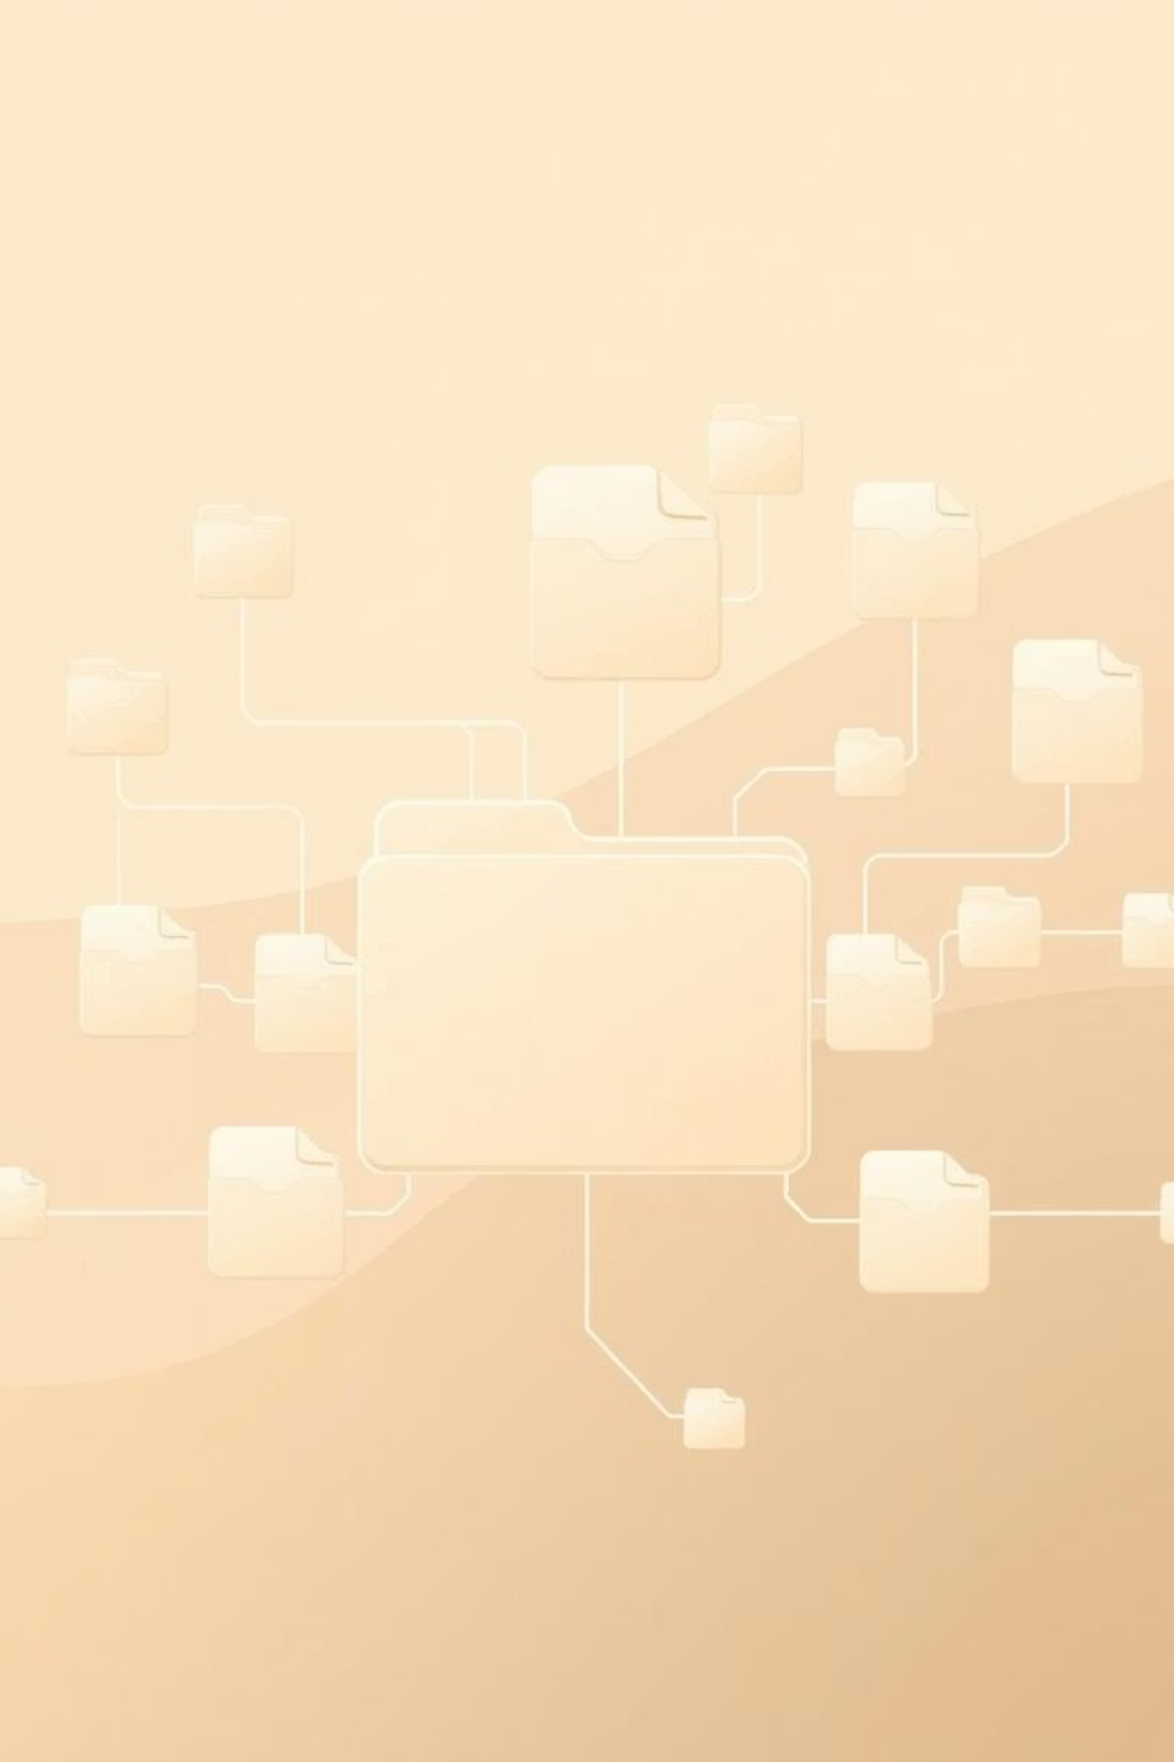
Directory Structures in Operating Systems
Single-Level, Two-Level & Hierarchical Structures
BSc CSIT – 4th Semester

Slide 2

What is a Directory?
Logical Container
A virtual space for files.
Organisation
Manages & accesses files efficiently.
Folders
Similar to familiar computer folders.

Slide 3





Why Use Directory Structures?
Prevent Conflicts
Faster Search
Efficient Organisation
Avoid identical file names.
Quickly locate files.
Manage millions of files.
Multi-User Support
Sharing & Permissions
Accommodate many users.
Control file access.

Slide 4
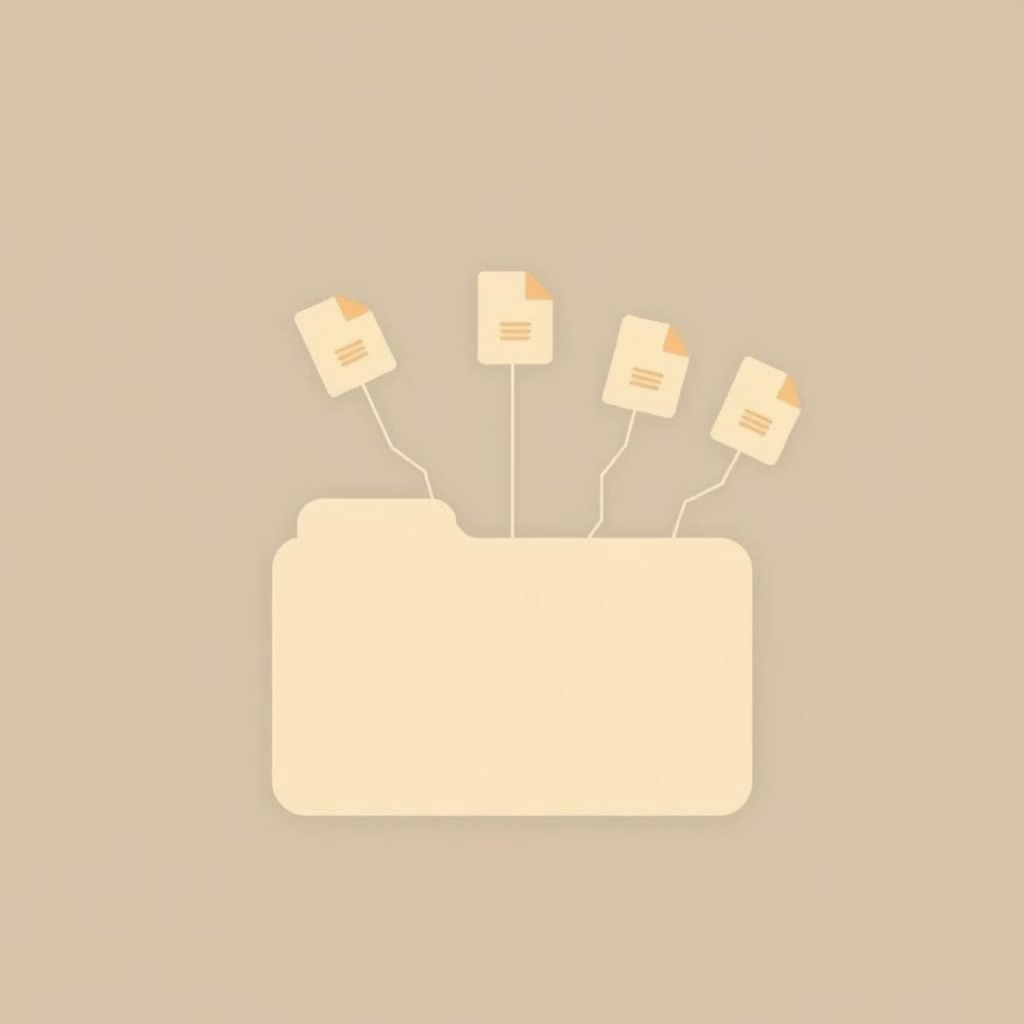
Single-Level Directory
Definition
All files reside in one central directory.
Features
Simple to implement.
Ideal for tiny systems.
Drawbacks
File name clashes.
Poor organisation as size grows.

Slide 5
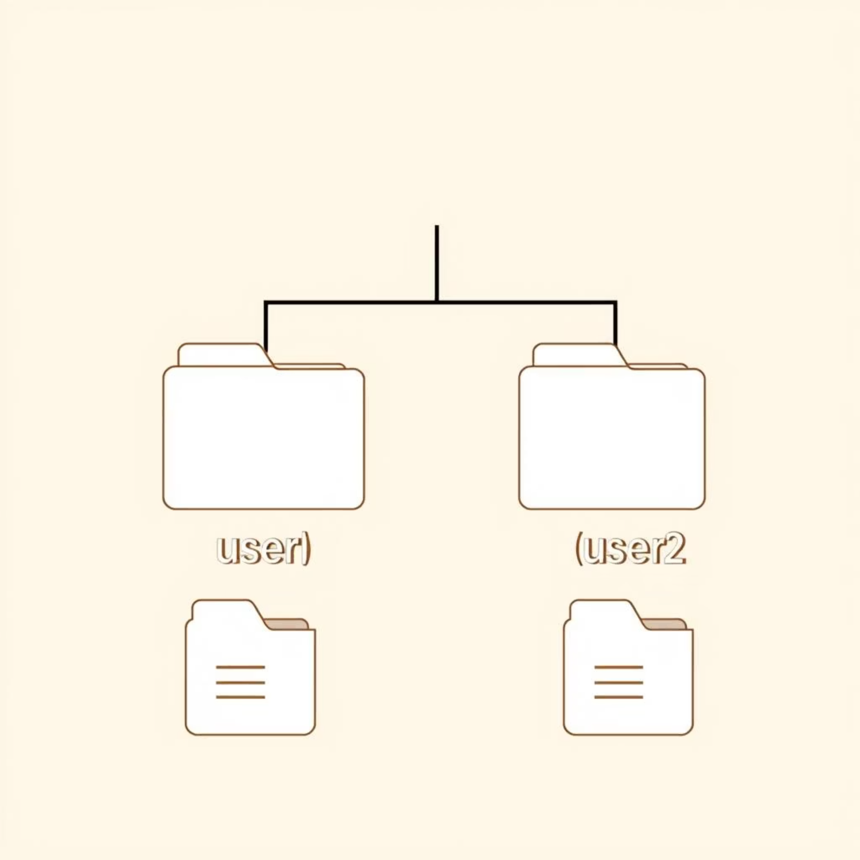
Two-Level Directory
Definition
A separate directory for each user.
Features
No inter-user file name conflicts.
Better for multi-user systems than single-level.
Limitations
Users cannot organise files within their own directories.

Slide 6
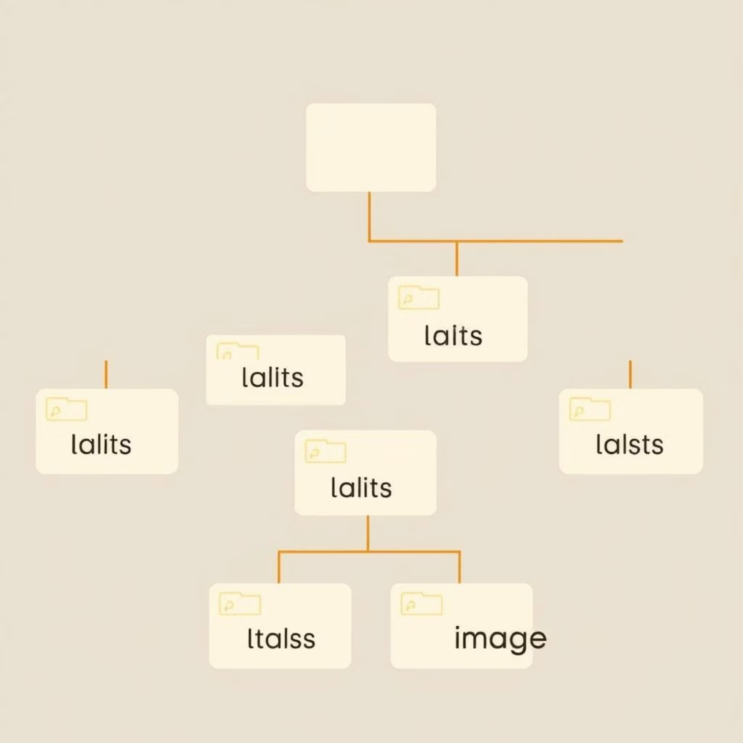
Hierarchical (Tree) Directory
Definition
Directories contain sub-directories, forming a tree structure.
Advantages
Highly flexible and organised.
Supports logical grouping (e.g., Documents, Music).
Unlimited levels of depth for superior organisation.

Slide 7
Directory Structure Comparison
Single-Level
Two-Level
Tree (Hierarchical)
Simplicity
✅ Simple
✅ Moderate
❌ Complex
File grouping
❌ No
❌ No
✅ Yes
Name conflicts
❌ Yes
✅ No
✅ No
Multi-user
❌ No
✅ Yes
✅ Yes

Slide 8

Evolving Needs, Evolving Structures
Modern Complexity
Multi-User Era
Hierarchical structures enable vast organisation.
Early Systems
Two-level solved user conflicts.
Simple needs, single-level was sufficient.
From basic file storage to complex data ecosystems, directory structures have adapted to meet the demands of modern computing, showcasing an ongoing evolution in operating system design.

Slide 9




Key Takeaways
Organisation
Single-Level
Structures are vital for file management.
Simple but limited, prone to conflicts.
Two-Level
Tree Structure
Multi-user support, lacks internal flexibility.
Most flexible & scalable, widely adopted.

